Slide 1
Lectures 1-3 MAN 325 Mathematical Imaging Techniques

Slide 2
Instructor
Dr. Sanjeev Kumar
Associate Professor
Department of Mathematics, IIT Roorkee
Can catch at : Room No. 302
mail at: malikfma@iitr.ac.in
gtalk: MALIKDMA@GMAIL

Slide 4
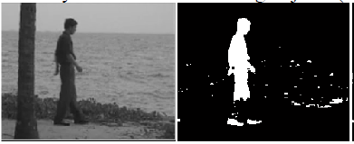

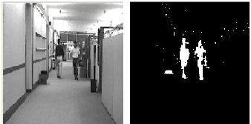
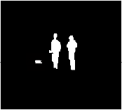

Slide 5
S. No. | Contents
1. | Image fundamentals: A simple image formation model, sampling and quantization, connectivity and adjacency relationships between pixels
2. | Spatial domain filtering: Basic intensity transformations: negative, log, power-law and piecewise linear transformations, bit-plane slicing, histogram equalization and matching, smoothing and sharpening filtering in spatial domain, unsharp masking and high-boost filtering
3. | Frequency domain filtering: Fourier Series and Fourier transform, discrete and fast Fourier transform, sampling theorem, aliasing, filtering in frequency domain, lowpass and highpass filters, bandreject and bandpass filters, notch filters
4. | Image restoration: Introduction to various noise models, restoration in presence of noise only, periodic noise reduction, linear and position invariant degradation, estimation of degradation function
5. | Image reconstruction: Principles of computed tomography, projections and Radon transform, the Fourier slice theorem, reconstruction using parallel-beam and fan-beam by filtered backprojection methods
6. | Mathematical morphology: Erosion and dilation, opening and closing, the Hit-or-Miss transformation, various morphological algorithms for binary images
7. | Wavelets and multiresolution processing: Image pyramids, subband coding, multiresolution expansions, the Haar transform, wavelet transform in one and two dimensions, discrete wavelet transform

Slide 6
Gonzalez, R. C. and Woods, R. E., "Digital Image Processing", Prentice Hall, 3rd Ed.
Jain, A. K., "Fundamentals of Digital Image Processing", PHI Learning, 1st Ed.
Bernd, J., "Digital Image Processing", Springer, 6th Ed.
Burger, W. and Burge, M. J., "Principles of Digital Image Processing", Springer
Scherzer, O., " Handbook of Mathematical Methods in Imaging", Springer

Slide 7
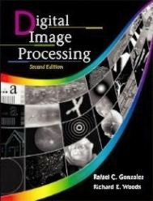

Slide 8

Image Acquisition Process

Slide 9
Introduction
What is Digital Image Processing?
Digital Image
— a two-dimensional function
x and y are spatial coordinates
The amplitude of f is called intensity or gray level at the point (x, y)
Digital Image Processing
— process digital images by means of computer, it covers low-, mid-, and high-level processes
low-level: inputs and outputs are images
mid-level: outputs are attributes extracted from input images
high-level: an ensemble of recognition of individual objects
Pixel
— the elements of a digital image

Slide 10
A Simple Image Formation Model

Slide 11
Some Typical Ranges of Reflectance
Reflectance
0.01 for black velvet
0.65 for stainless steel
0.80 for flat-white wall paint
0.90 for silver-plated metal
0.93 for snow

Slide 12
Image Sampling and Quantization
Digitizing the coordinate values
Digitizing the amplitude values

Slide 13
Image Sampling and Quantization

Slide 14
Representing Digital Images
The representation of an M×N numerical array as

Slide 15
Representing Digital Images
The representation of an M×N numerical array as

Slide 16
Representing Digital Images
The representation of an M×N numerical array in MATLAB

Slide 17
Representing Digital Images
Discrete intensity interval [0, L-1], L=2^{k}
The number b of bits required to store a M × N digitized image
b = M × N × k

Slide 18
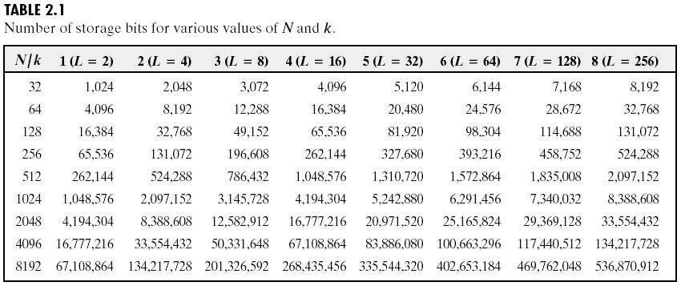
Representing Digital Images

Slide 19
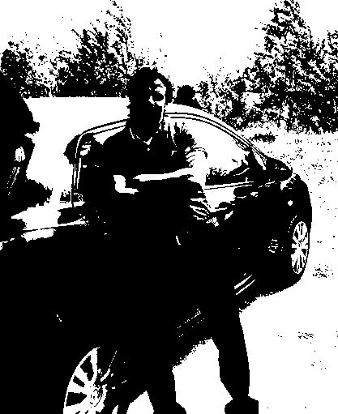


Notes:
As opposed to [0..255]

Slide 20







Slide 21




Slide 22
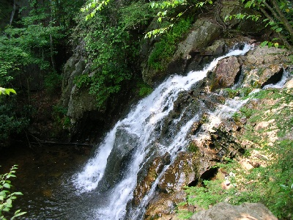
What is a Digital Image? (cont…)
Common image formats include:
1 sample per point (B&W or Grayscale)
3 samples per point (Red, Green, and Blue)
4 samples per point (Red, Green, Blue, and “Alpha”, a.k.a. Opacity)
For most of this course we will focus on grey-scale images

Slide 23

Image processing
An image processing operation typically defines a new image g in terms of an existing image f.
We can transform either the range of f.
Or the domain of f:
What kinds of operations can each perform?
Notes:
Use photoshop to make something grayscale

Slide 24
What is DIP? (cont…)
The continuum from image processing to computer vision can be broken up into low-, mid- and high-level processes
Low Level Process
Mid Level Process
High Level Process
Input: Image Output: Image
Examples: Noise removal, image sharpening
Input: Image Output: Attributes
Examples: Object recognition, segmentation
Input: Attributes Output: Understanding
Examples: Scene understanding, autonomous navigation
In this course we will stop here
Notes:
Give the analogy of the character recognition system.
Low Level: Cleaning up the image of some text
Mid level: Segmenting the text from the background and recognising individual characters
High level: Understanding what the text says

Slide 25
Key Stages in Digital Image Processing
Image Restoration
Morphological Processing
Image Enhancement
Segmentation
Image Acquisition
Object Recognition
Representation & Description
Problem Domain
Colour Image Processing
Image Compression

Slide 26

Key Stages in Digital Image Processing: Image Aquisition
Image Restoration
Morphological Processing
Image Enhancement
Segmentation
Image Acquisition
Object Recognition
Images taken from Gonzalez & Woods, Digital Image Processing (2002)
Representation & Description
Problem Domain
Colour Image Processing
Image Compression

Slide 27
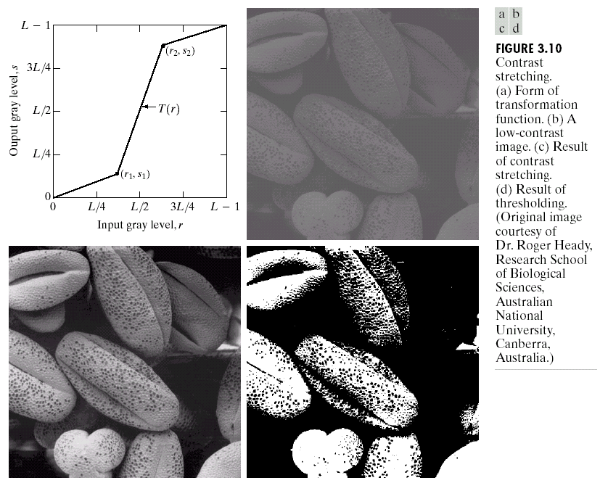
Key Stages in Digital Image Processing: Image Enhancement
Image Restoration
Morphological Processing
Image Enhancement
Segmentation
Image Acquisition
Object Recognition
Images taken from Gonzalez & Woods, Digital Image Processing (2002)
Representation & Description
Problem Domain
Colour Image Processing
Image Compression

Slide 28
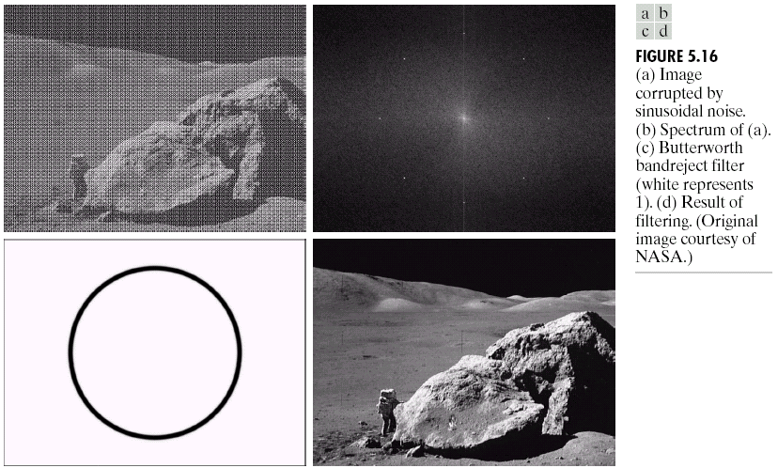
Key Stages in Digital Image Processing: Image Restoration
Image Restoration
Morphological Processing
Image Enhancement
Segmentation
Image Acquisition
Object Recognition
Images taken from Gonzalez & Woods, Digital Image Processing (2002)
Representation & Description
Problem Domain
Colour Image Processing
Image Compression

Slide 29
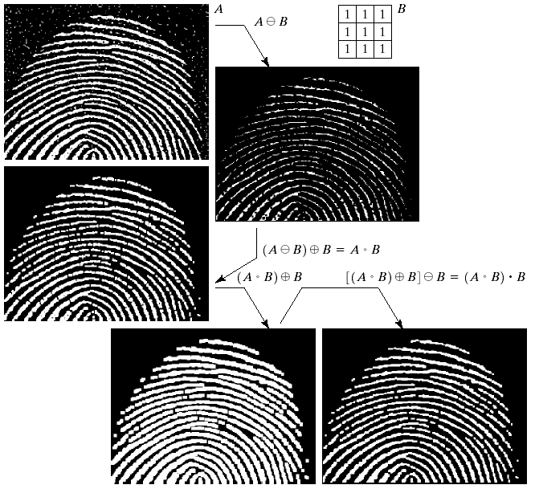
Key Stages in Digital Image Processing: Morphological Processing
Image Restoration
Morphological Processing
Image Enhancement
Segmentation
Image Acquisition
Object Recognition
Images taken from Gonzalez & Woods, Digital Image Processing (2002)
Representation & Description
Problem Domain
Colour Image Processing
Image Compression

Slide 30
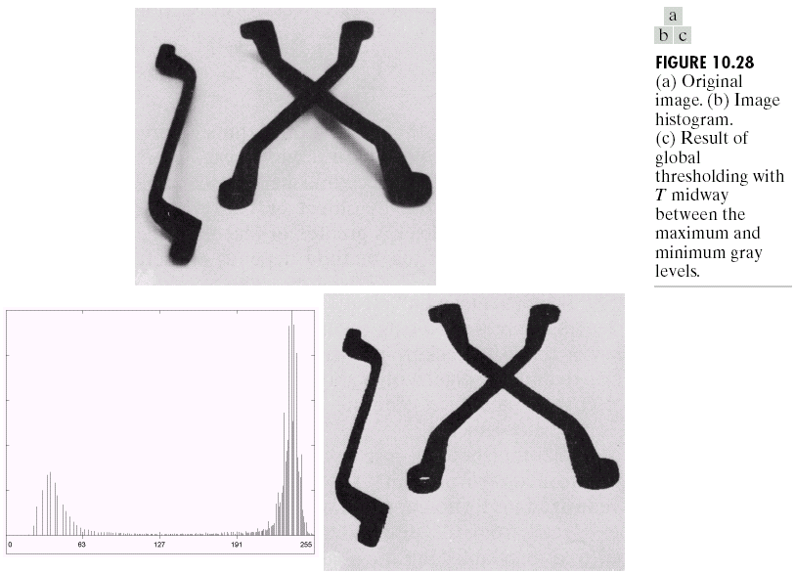
Key Stages in Digital Image Processing: Segmentation
Image Restoration
Morphological Processing
Image Enhancement
Segmentation
Image Acquisition
Object Recognition
Images taken from Gonzalez & Woods, Digital Image Processing (2002)
Representation & Description
Problem Domain
Colour Image Processing
Image Compression

Slide 31
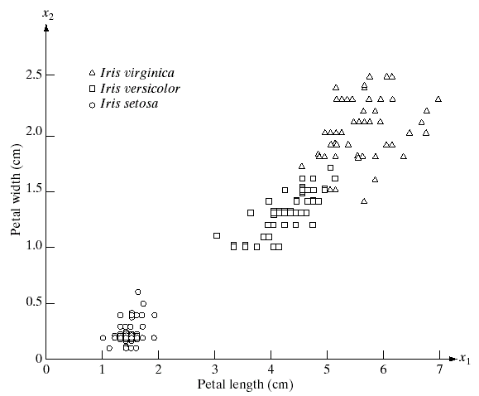
Key Stages in Digital Image Processing: Object Recognition
Image Restoration
Morphological Processing
Image Enhancement
Segmentation
Image Acquisition
Object Recognition
Images taken from Gonzalez & Woods, Digital Image Processing (2002)
Representation & Description
Problem Domain
Colour Image Processing
Image Compression

Slide 32
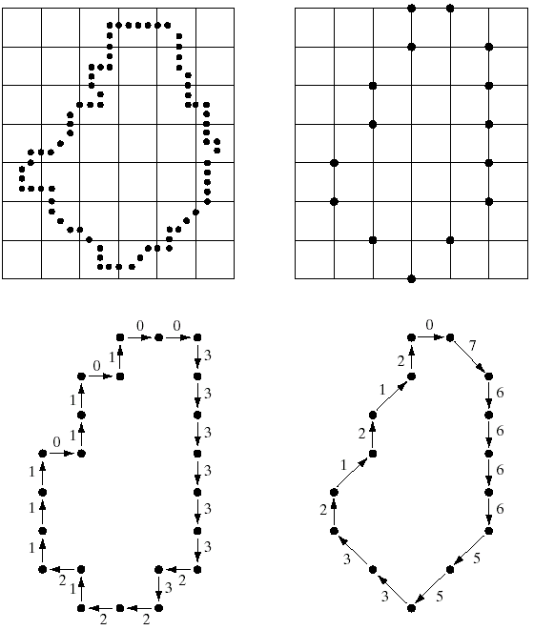
Key Stages in Digital Image Processing: Representation & Description
Image Restoration
Morphological Processing
Image Enhancement
Segmentation
Image Acquisition
Object Recognition
Images taken from Gonzalez & Woods, Digital Image Processing (2002)
Representation & Description
Problem Domain
Colour Image Processing
Image Compression

Slide 33
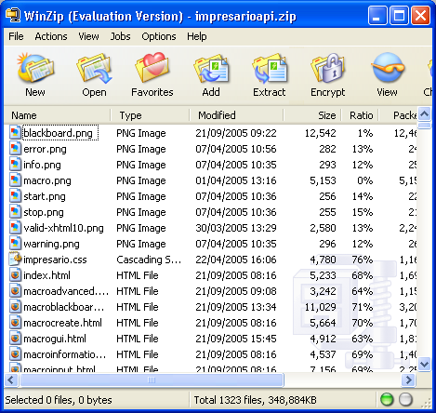
Key Stages in Digital Image Processing: Image Compression
Image Restoration
Morphological Processing
Image Enhancement
Segmentation
Image Acquisition
Object Recognition
Representation & Description
Problem Domain
Colour Image Processing
Image Compression

Slide 34
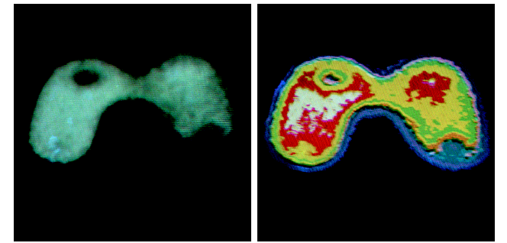
Key Stages in Digital Image Processing: Colour Image Processing
Image Restoration
Morphological Processing
Image Enhancement
Segmentation
Image Acquisition
Object Recognition
Representation & Description
Problem Domain
Colour Image Processing
Image Compression

Slide 35
Applications
&
Research Topics

Slide 36
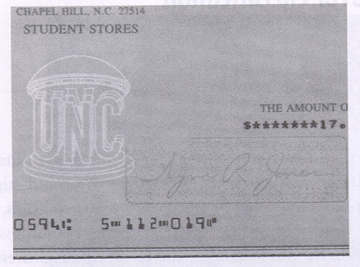
Document Handling

Slide 37

Signature Verification

Slide 38
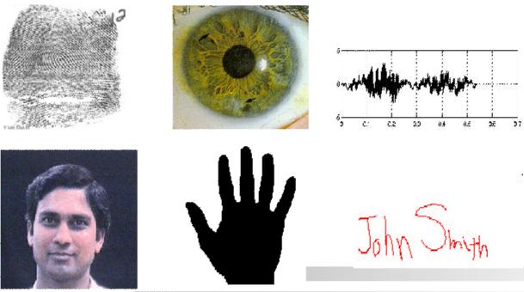
Biometrics

Slide 39
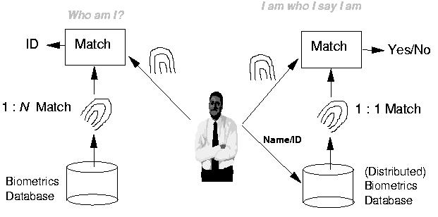
Fingerprint Verification / Identification

Slide 40

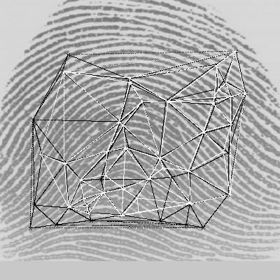
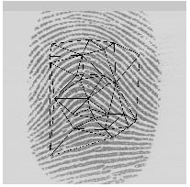
Fingerprint Identification Research at UNR
Minutiae Matching
Delaunay Triangulation

Slide 41

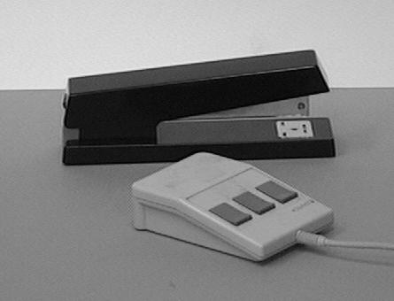
Object Recognition

Slide 42
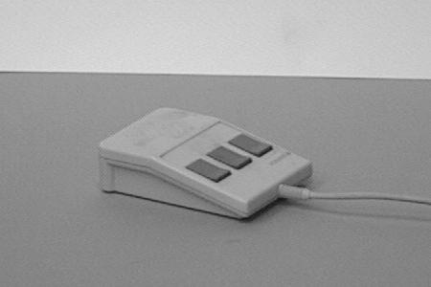
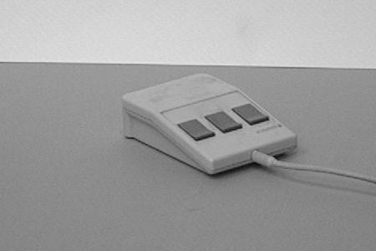
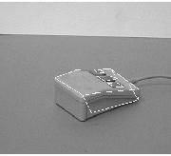
Object Recognition Research
reference view 1 reference view 2
novel view recognized

Slide 43
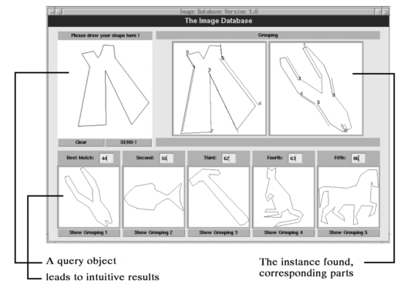
Indexing into Databases
Shape content

Slide 44
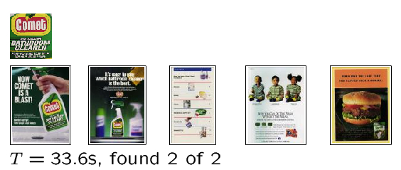
Indexing into Databases (cont’d)
Color, texture

Slide 45
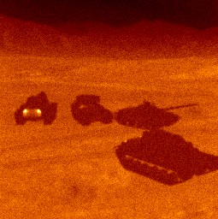
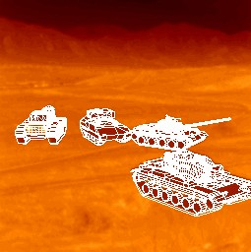
Target Recognition
Department of Defense (Army, Airforce, Navy)

Slide 46
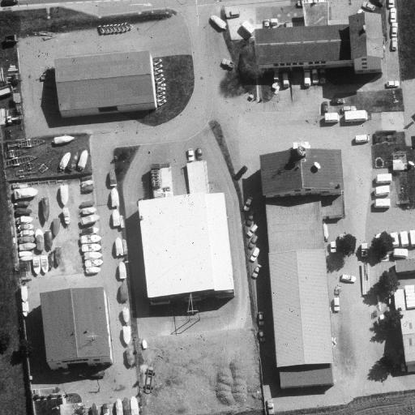
Interpretation of Aerial Photography
Interpretation of aerial photography is a problem domain in both computer vision and registration.

Slide 47
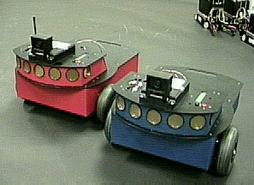
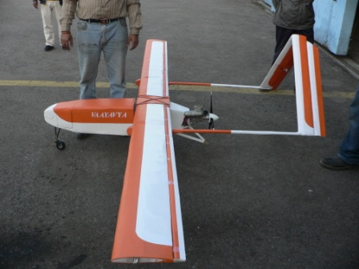
Autonomous Vehicles
Land, Underwater, Space

Slide 48
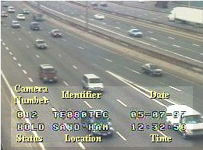
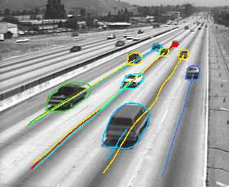
Traffic Monitoring

Slide 49
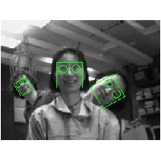
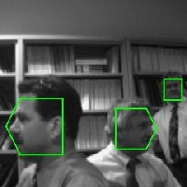
Face Detection

Slide 50
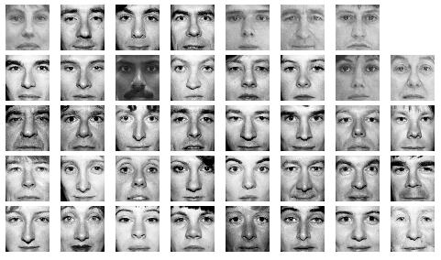
Face Recognition

Slide 51
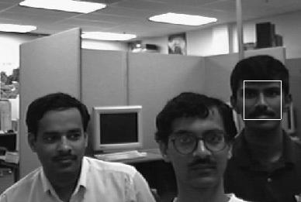
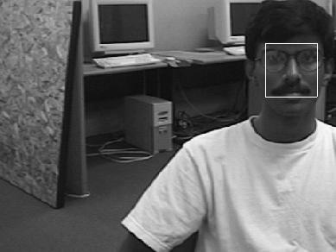
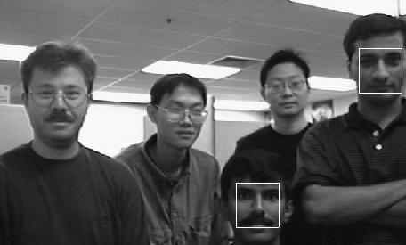
Face Detection/Recognition Research at UNR

Slide 52
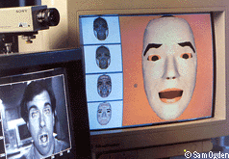
Facial Expression Recognition

Slide 53


Face Tracking

Slide 54


Face Tracking (cont’d)

Slide 55

Hand Gesture Recognition
Smart Human-Computer User Interfaces
Sign Language Recognition

Slide 56
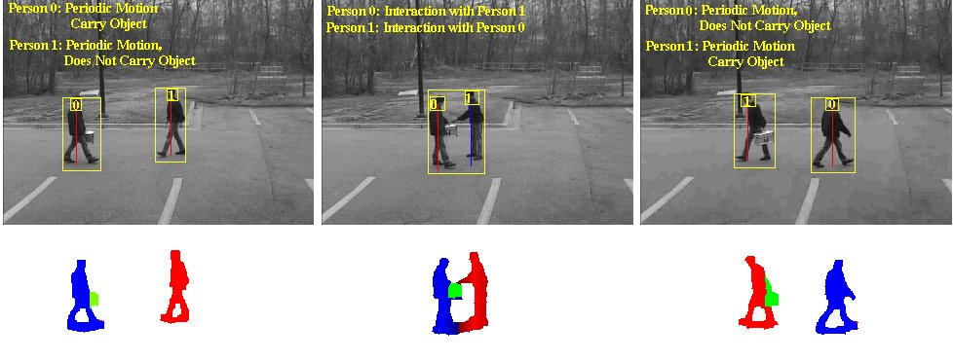
Human Activity Recognition

Slide 57
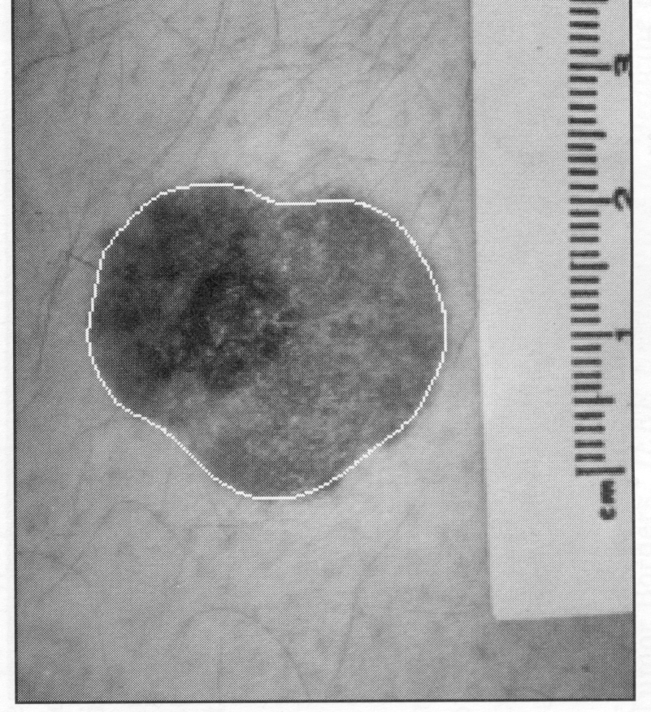
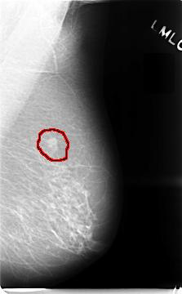
Medical Applications
skin cancer breast cancer

Slide 58
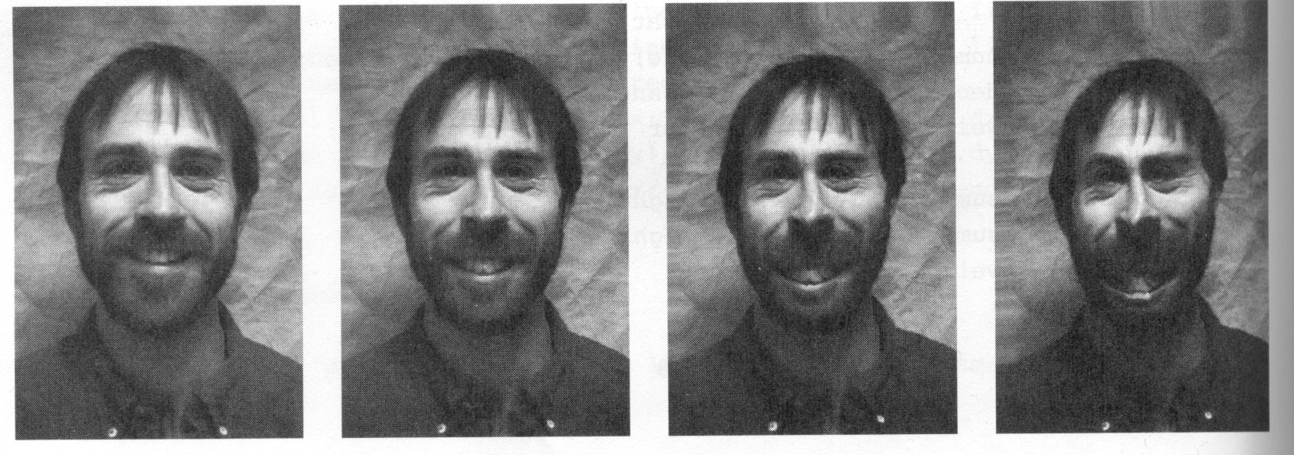
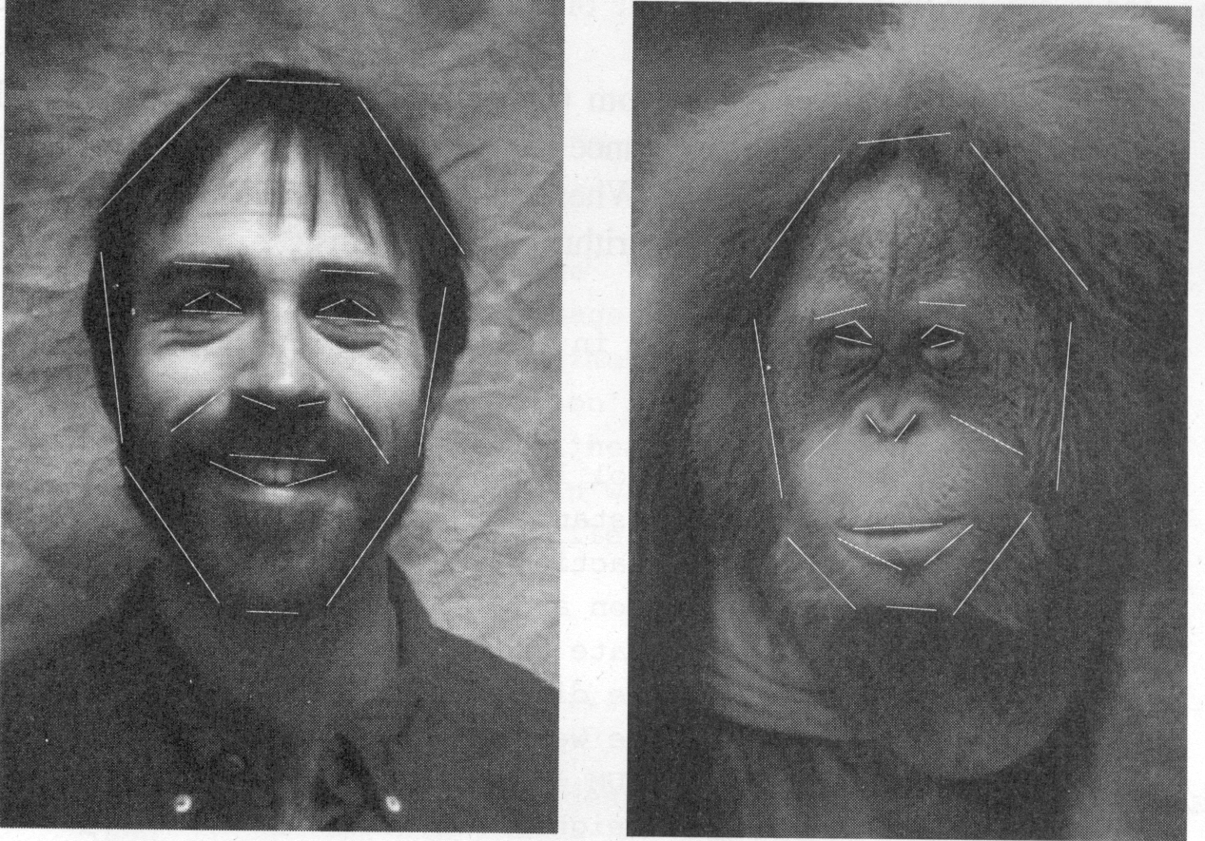
Morphing

Slide 59
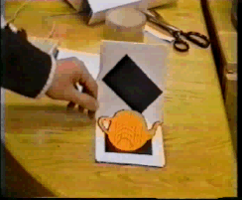
Inserting Artificial Objects into a Scene

Slide 60
Companies In this Field In India
Sarnoff Corporation
Kritikal Solutions
National Instruments
GE Laboratories
Ittiam, Bangalore
Interra Systems, Noida
Yahoo India (Multimedia Searching)
nVidia Graphics, Pune (have high requirements)
Microsoft research
DRDO labs
ISRO labs
…

Slide 61
Neighborhood Operations in Images

Slide 62
Basic Relationships Between Pixels
Neighborhood
Adjacency
Connectivity
Paths
Regions and boundaries

Slide 63
Basic Relationships Between Pixels
Neighbors of a pixel p at coordinates (x,y)
4-neighbors of p, denoted by N₄(p):
(x-1, y), (x+1, y), (x,y-1), and (x, y+1).
4 diagonal neighbors of p, denoted by N_{D}(p):
(x-1, y-1), (x+1, y+1), (x+1,y-1), and (x-1, y+1).
8 neighbors of p, denoted N₈(p)
N₈(p) = N₄(p) U N_{D}(p)

Slide 64
Basic Relationships Between Pixels
Adjacency
Let V be the set of intensity values
4-adjacency: Two pixels p and q with values from V are 4-adjacent if q is in the set N₄(p).
8-adjacency: Two pixels p and q with values from V are 8-adjacent if q is in the set N₈(p).

Slide 65
Basic Relationships Between Pixels
Adjacency
Let V be the set of intensity values
m-adjacency: Two pixels p and q with values from V are m-adjacent if
(i) q is in the set N₄(p), or
(ii) q is in the set N_{D}(p) and the set N₄(p) ∩ N₄(p) has no pixels whose values are from V.

Slide 66
Basic Relationships Between Pixels
Path
A (digital) path (or curve) from pixel p with coordinates (x₀, y₀) to pixel q with coordinates (x_{n}, y_{n}) is a sequence of distinct pixels with coordinates
(x₀, y₀), (x₁, y₁), …, (x_{n}, y_{n})
Where (x_{i}, y_{i}) and (x_{i-1}, y_{i-1}) are adjacent for 1 ≤ i ≤ n.
Here n is the length of the path.
If (x₀, y₀) = (x_{n}, y_{n}), the path is closed path.
We can define 4-, 8-, and m-paths based on the type of adjacency used.

Slide 67
Examples: Adjacency and Path
V = {1, 2}
0 1 1 0 1 1 0 1 1
0 2 0 0 2 0 0 2 0
0 0 1 0 0 1 0 0 1

Slide 68
Examples: Adjacency and Path
V = {1, 2}
0 1 1 0 1 1 0 1 1
0 2 0 0 2 0 0 2 0
0 0 1 0 0 1 0 0 1
8-adjacent

Slide 69
Examples: Adjacency and Path
V = {1, 2}
0 1 1 0 1 1 0 1 1
0 2 0 0 2 0 0 2 0
0 0 1 0 0 1 0 0 1
8-adjacent
m-adjacent

Slide 70
Examples: Adjacency and Path
V = {1, 2}
01,1 11,2 11,3 0 1 1 0 1 1
02,1 22,2 02,3 0 2 0 0 2 0
03,1 03,2 13,3 0 0 1 0 0 1
8-adjacent
m-adjacent
The 8-path from (1,3) to (3,3):
(1,3), (1,2), (2,2), (3,3)
(1,3), (2,2), (3,3)
The m-path from (1,3) to (3,3):
(1,3), (1,2), (2,2), (3,3)

Slide 71
Basic Relationships Between Pixels
Connected in S
Let S represent a subset of pixels in an image. Two pixels p with coordinates (x₀, y₀) and q with coordinates (x_{n}, y_{n}) are said to be connected in S if there exists a path
(x₀, y₀), (x₁, y₁), …, (x_{n}, y_{n})
Where

Slide 72
Basic Relationships Between Pixels
Let S represent a subset of pixels in an image
For every pixel p in S, the set of pixels in S that are connected to p is called a connected component of S.
If S has only one connected component, then S is called Connected Set.
We call R a region of the image if R is a connected set
Two regions, R_{i} and R_{j} are said to be adjacent if their union forms a connected set.
Regions that are not to be adjacent are said to be disjoint.

Slide 73

Basic Relationships Between Pixels

Slide 74

Basic Relationships Between Pixels

Slide 75
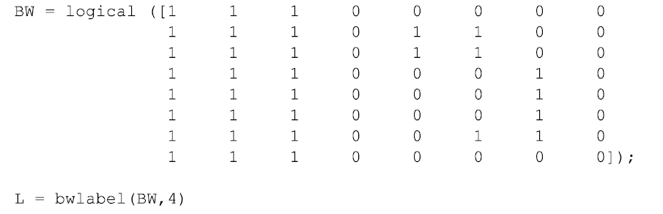
Basic Relationships Between Pixels

Slide 76
Basic Relationships Between Pixels
BW = imread('text.png');
imshow(BW);
CC = bwconncomp(BW);
numPixels = cellfun(@numel,CC.PixelIdxList);
[biggest,idx] = max(numPixels);
BW(CC.PixelIdxList{idx}) = 0;
figure, imshow(BW);

Slide 77
Basic Relationships Between Pixels
Boundary (or border)
The boundary of the region R is the set of pixels in the region that have one or more neighbors that are not in R.
If R happens to be an entire image, then its boundary is defined as the set of pixels in the first and last rows and columns of the image.
Foreground and background
An image contains K disjoint regions, R_{k}, k = 1, 2, …, K. Let R_{u} denote the union of all the K regions, and let (R_{u})^{c} denote its complement.
All the points in R_{u} is called foreground;
All the points in (R_{u})^{c} is called background.

Slide 78
Question 1
In the following arrangement of pixels, are the two regions (of 1s) adjacent? (if 8-adjacency is used)
1 1 1
1 0 1
0 1 0
0 0 1
1 1 1
1 1 1
Region 1
Region 2

Slide 79
Question 2
In the following arrangement of pixels, are the two parts (of 1s) adjacent? (if 4-adjacency is used)
1 1 1
1 0 1
0 1 0
0 0 1
1 1 1
1 1 1
Part 1
Part 2

Slide 80
In the following arrangement of pixels, the two regions (of 1s) are disjoint (if 4-adjacency is used)
1 1 1
1 0 1
0 1 0
0 0 1
1 1 1
1 1 1
Region 1
Region 2

Slide 81
In the following arrangement of pixels, the two regions (of 1s) are disjoint (if 4-adjacency is used)
1 1 1
1 0 1
0 1 0
0 0 1
1 1 1
1 1 1
foreground
background

Slide 82
Question 3
In the following arrangement of pixels, the circled point is part of the boundary of the 1-valued pixels if 8-adjacency is used, true or false?
0 0 0 0 0
0 1 1 0 0
0 1 1 0 0
0 1 1 1 0
0 1 1 1 0
0 0 0 0 0

Slide 83
Question 4
In the following arrangement of pixels, the circled point is part of the boundary of the 1-valued pixels if 4-adjacency is used, true or false?
0 0 0 0 0
0 1 1 0 0
0 1 1 0 0
0 1 1 1 0
0 1 1 1 0
0 0 0 0 0

Slide 84
Distance Measures
Given pixels p, q and z with coordinates (x, y), (s, t), (u, v) respectively, the distance function D has following properties:
D(p, q) ≥ 0 [D(p, q) = 0, iff p = q]
D(p, q) = D(q, p)
D(p, z) ≤ D(p, q) + D(q, z)

Slide 85
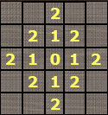
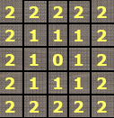
Distance Measures
The following are the different Distance measures:
a. Euclidean Distance :
D_{e}(p, q) = [(x-s)² + (y-t)²]^{1/2}
b. City Block Distance:
D₄(p, q) = |x-s| + |y-t|
c. Chess Board Distance:
D₈(p, q) = max(|x-s|, |y-t|)

Slide 86
Question 5
In the following arrangement of pixels, what’s the value of the chessboard distance between the circled two points?
0 0 0 0 0
0 0 1 1 0
0 1 1 0 0
0 1 0 0 0
0 0 0 0 0
0 0 0 0 0

Slide 87
Question 6
In the following arrangement of pixels, what’s the value of the city-block distance between the circled two points?
0 0 0 0 0
0 0 1 1 0
0 1 1 0 0
0 1 0 0 0
0 0 0 0 0
0 0 0 0 0

Slide 88
Introduction to Mathematical Operations in DIP
Array vs. Matrix Operation
Array product
operator
Array product
Matrix product
operator
Matrix product

Slide 89
Introduction to Mathematical Operations in DIP
Linear vs. Nonlinear Operation
H is said to be a linear operator;
H is said to be a nonlinear operator if it does not meet the above qualification.
Additivity
Homogeneity

Slide 90
Arithmetic Operations
Arithmetic operations between images are array operations. The four arithmetic operations are denoted as
s(x,y) = f(x,y) + g(x,y)
d(x,y) = f(x,y) – g(x,y)
p(x,y) = f(x,y) × g(x,y)
v(x,y) = f(x,y) ÷ g(x,y)

Slide 91
Example: Addition of Noisy Images for Noise Reduction
Noiseless image: f(x,y)
Noise: n(x,y) (at every pair of coordinates (x,y), the noise is uncorrelated and has zero average value)
Corrupted image: g(x,y)
g(x,y) = f(x,y) + n(x,y)
Reducing the noise by adding a set of noisy images, {g_{i}(x,y)}

Slide 92
Example: Addition of Noisy Images for Noise Reduction

Slide 93
Example: Addition of Noisy Images for Noise Reduction
In astronomy, imaging under very low light levels frequently causes sensor noise to render single images virtually useless for analysis.
In astronomical observations, similar sensors for noise reduction by observing the same scene over long periods of time. Image averaging is then used to reduce the noise.

Slide 94
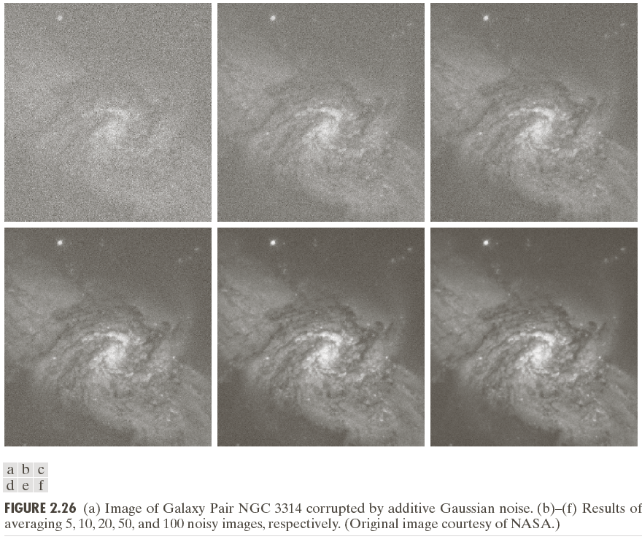

Slide 95
An Example of Image Subtraction: Mask Mode Radiography
Mask h(x,y): an X-ray image of a region of a patient’s body
Live images f(x,y): X-ray images captured at TV rates after injection of the contrast medium
Enhanced detail g(x,y)
g(x,y) = f(x,y) - h(x,y)
The procedure gives a movie showing how the contrast medium propagates through the various arteries in the area being observed.

Slide 96


Slide 97

An Example of Image Multiplication

Slide 98
Set and Logical Operations

Slide 99
Set and Logical Operations
Let A be the elements of a gray-scale image
The elements of A are triplets of the form (x, y, z), where x and y are spatial coordinates and z denotes the intensity at the point (x, y).
The complement of A is denoted A^{c}

Slide 100
Set and Logical Operations
The union of two gray-scale images (sets) A and B is defined as the set

Slide 101
Set and Logical Operations

Slide 102

Set and Logical Operations

Slide 103

Spatial Operations
Single-pixel operations
Alter the values of an image’s pixels based on the intensity.
e.g.,

Slide 104
Spatial Operations
Neighborhood operations
The value of this pixel is determined by a specified operation involving the pixels in the input image with coordinates in S_{xy}

Slide 105
Spatial Operations
Neighborhood operations

Slide 106
Geometric Spatial Transformations
Geometric transformation (rubber-sheet transformation)
— A spatial transformation of coordinates
— intensity interpolation that assigns intensity values to the spatially transformed pixels.
Affine transform

Slide 108
Image Registration
Input and output images are available but the transformation function is unknown.
Goal: estimate the transformation function and use it to register the two images.
One of the principal approaches for image registration is to use tie points (also called control points)
The corresponding points are known precisely in the input and output (reference) images.

Slide 109
Image Registration
A simple model based on bilinear approximation:

Slide 110
Image Registration

Slide 111
Image Transform
A particularly important class of 2-D linear transforms, denoted T(u, v)

Slide 112
Image Transform
Given T(u, v), the original image f(x, y) can be recoverd using the inverse tranformation of T(u, v).

Slide 113

Image Transform

Slide 114
Example: Image Denoising by Using DCT Transform

Slide 115
Forward Transform Kernel

Slide 116
The Kernels for 2-D Fourier Transform

Slide 117
2-D Fourier Transform

Slide 118
Probabilistic Methods

Slide 119
Probabilistic Methods

Slide 120
Example: Comparison of Standard Deviation Values

